Slide 1
CA Pradeep Jain
Your Need Our Concern

Slide 2
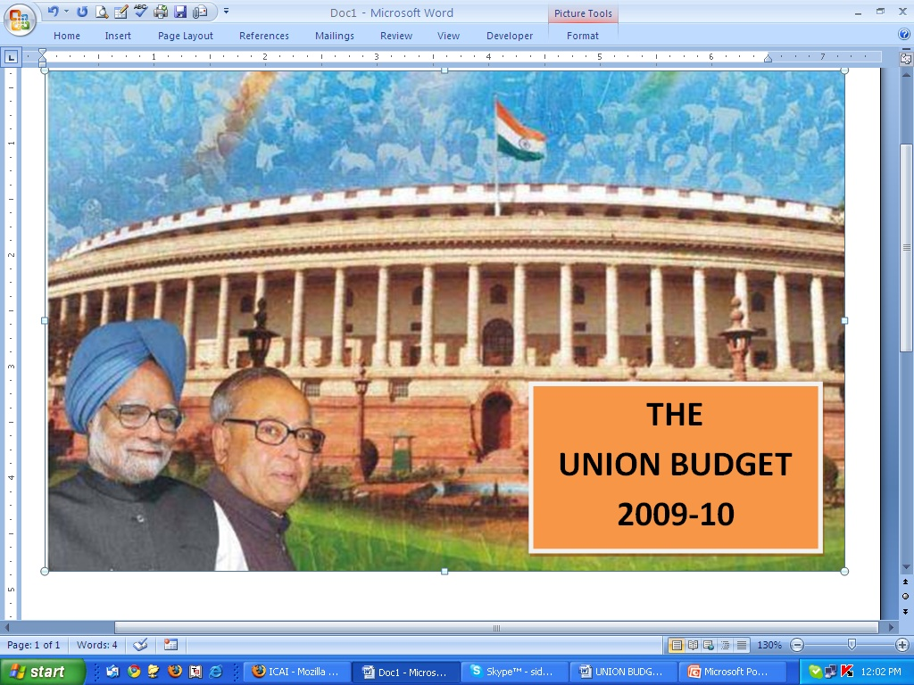
CA. PRADEEP JAIN
YOUR NEED OUR CONCERN…

Slide 3


Demands
Rate of Excise Duty and Service tax should remain at present level.
o
f
All type of Cess should be clubbed with Excise duty and service tax.
Industries
100% Cenvat credit on capital goods should be allowed to be taken in the year of receipt of capital goods.
Applicability of GST should delayed by one more year.
SSI Exemption limit should be increased upto 3 Crores and similarly, the SSI exemption to service providers should also be increased upto 12 Lacs.
Reversal under Rule 6 of Cenvat Credit Rules is also required to be reduced.
Proportionate reversal under Rule 6 of Cenvat Credit Rules is requires to be simplified.
The duty under compounded levy scheme should also required to be reduced.
Under Works Contract scheme the rate of service tax payable is also required to be reduced.
Exporters should get more sops:
  In place of refund of service tax, the exemption is to be granted.
  DEPB Scheme is to be extended beyond December, 2009.
Created & Presented By: - CA. Pradeep Jain “Your Need Our Concern” Visit us at: www.capradeepjain.com

Slide 4
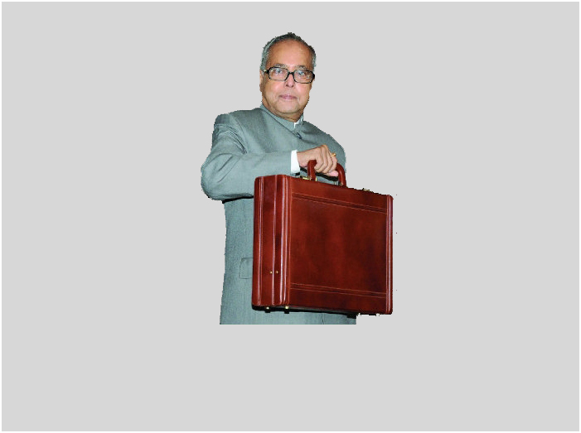
HIGHLIGHTS OF UNION BUDGET 2009-10
EXCISE
SERVICE TAX
No Change in Service Tax Rate.
No Change in Basic Excise Duty.
No Exemption to Chartered accountants.
4% Excise Duty increased to 8% with few exceptions.
Revised Refund procedure for exporters.
SSI exemption clause of Brand Name does not hit Printed Laminated Rolls.
NEW Services:
Legal Services
Plastic Surgery
Transport of goods by Rail, Water & Pipe Line.
Optional Duty on Textile is back.
GST will be effective from April 1, 2010.
Rate of Reversal of CENVAT Credit reduced to 6%.
Created & Presented By: - CA. Pradeep Jain Visit us at: www.capradeepjain.com
Created & Presented By: - CA. Pradeep Jain “Your Need Our Concern” Visit us at: www.capradeepjain.com

Slide 5


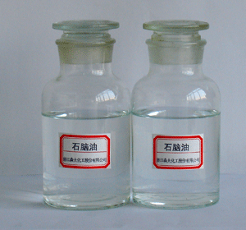
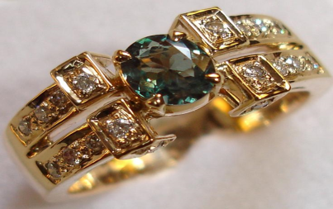


CHANGE IN RATES
RATES DECLINED
Special Boiling Point Spirits.
Naphtha
Jewellery having brand name / trade name affixed on itself.
Motor vehicles having engine capacity exceeding 1999cc.
Petrol Driven Motor Vehicles and there chassis.
Created & Presented By: - CA. Pradeep Jain Visit us at: www.capradeepjain.com
Created & Presented By: - CA. Pradeep Jain “Your Need Our Concern” Visit us at: www.capradeepjain.com

Slide 6
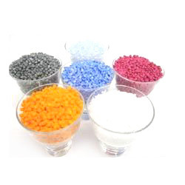
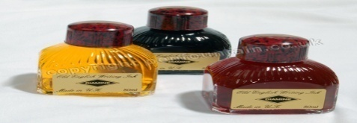
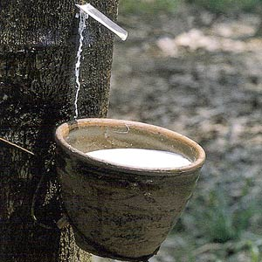
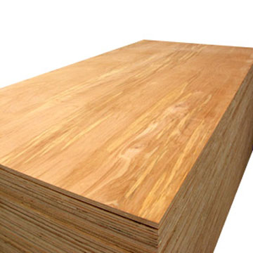

CHANGE IN RATES
RATES UPSURGED
Pure Terephthalic acid & Dimethyl Terephthalate.
Ink used in Writing Instruments.
Polyester Chips.
Heat resistant Latex Rubber Thread & Tension tapes.
Particle board /oriented strand board/ Fiber board /Plywood, veneered panels & Flush doors.
Folders, file covers, manifold business forms, Paper & Labels.
Created & Presented By: - CA. Pradeep Jain Visit us at: www.capradeepjain.com
Created & Presented By: - CA. Pradeep Jain “Your Need Our Concern” Visit us at: www.capradeepjain.com

Slide 7


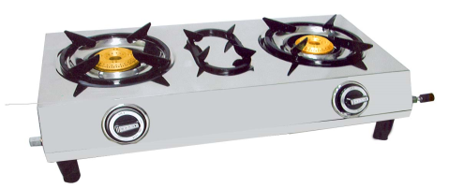
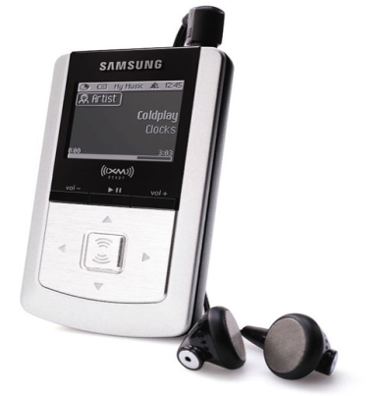
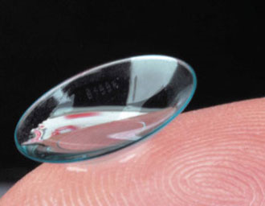

CHANGE IN RATES
RATES UPSURGED
Textile Goods made of Pure Cotton.
Ceramic Tiles.
LPG Gas stoves.
MP3/ MP4 or MPEG 4 players.
Contact Lenses.
Playing Cards
Created & Presented By: - CA. Pradeep Jain Visit us at: www.capradeepjain.com
Created & Presented By: - CA. Pradeep Jain “Your Need Our Concern” Visit us at: www.capradeepjain.com

Slide 8

KEY ISSUES IN EXCISE
Full exemption from excise duty to Goods under Chapter 68 manufactured at site for use in construction work at such sites.
‘Printed Laminated Rolls’ added to SSI Exemption list.
Cement, angles, channels, CTD or TMT bar & other items used for construction of shed, building or structure excluded from definition of “Inputs”.
Reversal under Rule 6(3) of the Cenvat Credit Rules, 2004 reduced from 10% to 5%.
Betel nuts reclassified.
Created & Presented By: - CA. Pradeep Jain Visit us at: www.capradeepjain.com
Created & Presented By: - CA. Pradeep Jain “Your Need Our Concern” Visit us at: www.capradeepjain.com

Slide 9
KEY ISSUES IN EXCISE
Power to condone the delay in filing of appeals vested to High Courts.
Amendments in Rule 9A(2), Rule 14A & Rule 23A.
Compounded levy for induction furnace units amended retrospectively.
Documents Seized by the Department to be returned within a month.
Created & Presented By: - CA. Pradeep Jain Visit us at: www.capradeepjain.com
Created & Presented By: - CA. Pradeep Jain “Your Need Our Concern” Visit us at: www.capradeepjain.com

Slide 10

KEY ISSUES IN SERVICE TAX
New Services Added:
Transport of Goods through Rail
Transport of Coastal Goods & Goods transported through Inland water
Legal Consultancy Service
Cosmetic and Plastic Surgery service
Changes in Business Auxiliary Service (BAS).
Stock-broker Service to exclude services provided by Sub-Brokers.
Information Technology Software Service amended.
Revision of orders under Section 84 amended.
Created & Presented By: - CA. Pradeep Jain Visit us at: www.capradeepjain.com
Created & Presented By: - CA. Pradeep Jain “Your Need Our Concern” Visit us at: www.capradeepjain.com

Slide 11

KEY ISSUES IN SERVICE TAX
Services received by Goods Transport Agents (GTAs) exempted with retrospective effect.
Works Contract (Composition Scheme for Payment of Service Tax) Rules, 2007 amended.
Reversal rate under Rule 6(3) reduced from 8% to 6%.
New Exemptions to:
Private bus operators
Inter-Bank transactions of purchase or sale of foreign currency.
FIEO & 21 specified EPC’s.
Refund Scheme of ST to exporters revised.
Created & Presented By: - CA. Pradeep Jain Visit us at: www.capradeepjain.com
Created & Presented By: - CA. Pradeep Jain “Your Need Our Concern” Visit us at: www.capradeepjain.com

Slide 12

NEW SCHEME FOR REFUND OF SERVICE TAX TO THE EXPORTERS
This scheme have two parts: -
  Exemption
  Refund based on self certification.
Exemption: -
  BAS – Commission paid to foreign agents.
  Transport of goods by road
  For the same Exporter have to file a declaration and six monthly return.
Refund based on self certification: -
  Unregistered exporters has to obtain service tax code (STC).
  Refund claim with in one year from the date of export.
  Refund application in prescribed manner.
  Self certified original documents to be submitted. Or
  Certified from the C.A.
  Department will examine the same.
  BRC to be submitted later on.
  Changes in conditions of eligible services.
  Terminal handling charges included.
Created & Presented By: - CA. Pradeep Jain Visit us at: www.capradeepjain.com
Created & Presented By: - CA. Pradeep Jain “Your Need Our Concern” Visit us at: www.capradeepjain.com

Slide 13

IMPACT OF BUDGET ON VARIOUS INDUSTRIES
INFORMATION TECHNOLOGY INDUSTRY
Partial exemption from excise duty on packaged/canned software assure well for the industry.
Recorded smart card and tags are exempt from excise duty subject to certain conditions.
The extension of Tax holidays by a year, upto March 31, 2011, However, on the other side the positive impact of the extension is expected to be nullified by an increase in MAT from 10 % to 15%.
A correction has been carried out in the definition of the taxable service to clarify that the providing of ‘right to use’ is taxable service and the acquiring of ‘right to use’ is not taxable service. This amendment would have retrospective effect from 16.05.2008.
Created & Presented By: - CA. Pradeep Jain Visit us at: www.capradeepjain.com
Created & Presented By: - CA. Pradeep Jain “Your Need Our Concern” Visit us at: www.capradeepjain.com

Slide 14

IMPACT OF BUDGET ON VARIOUS INDUSTRIES
TRANSPORT INDUSTRY
Now the service tax will also leviable on goods transported by Government railways, whether in containers or otherwise.
Coastal goods and transport of goods through National Waterways, and inland waters are proposed to be brought under tax net.
In respect of credit of service tax paid by GTAs, Government has promised to drop all past demands/litigation, latest by the end of August, 2009. By giving retrospective effect to notification no. 1/2009-ST (w.e.f. 01-01-2005)
Created & Presented By: - CA. Pradeep Jain Visit us at: www.capradeepjain.com
Created & Presented By: - CA. Pradeep Jain “Your Need Our Concern” Visit us at: www.capradeepjain.com

Slide 15
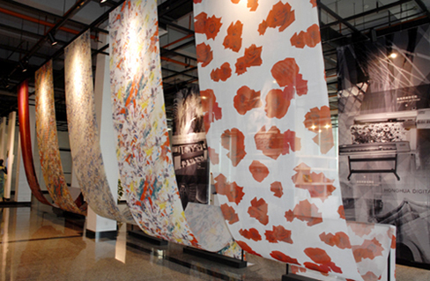
IMPACT OF BUDGET ON VARIOUS INDUSTRIES
TEXTILE INDUSTRY
The excise duty applicable to the textiles, Position prior to the reductions made on the 7th of December, 2008 is being restored. Optional duty regime restored.
A manufacturer does not avail the Cenvat credit of the duty paid on inputs can take the Full exemption.
In respect of manmade fibre and yarn the rate of duty has been enhanced from 4% to 8% on mandatory basis.
The items manufactured from natural fibres other than cotton such as silk, wool, flax etc. would now bear an optional levy of 8% ad valorem instead of 4%.
Corresponding changes have also been applicable to EOU that use only indigenous raw materials and make clearances of textile items into the DTA.
Excise duty on some important textile intermediates has also been enhanced from 4% to 8% ad valorem. These are: a) Polyester chips
  b) Di-methyl terephthalate (DMT)
  c) Pure Terephthalic Acid (PTA); and
    d) Acrylonitrile
Created & Presented By: - CA. Pradeep Jain Visit us at: www.capradeepjain.com
Created & Presented By: - CA. Pradeep Jain “Your Need Our Concern” Visit us at: www.capradeepjain.com

Slide 16

IMPACT OF BUDGET ON VARIOUS INDUSTRIES
CONSTRUCTION INDUSTRY
Full exemption from excise duty has been provided to goods manufactured at the site for use in construction work at such site.
Rule (2) of Cenvat Credit Rules, 2004 has been amended to clarify that ‘input’ should not include cement, angles, channels, CTD/TMT bars etc. used for construction of shed, building or structure for support of capital goods.
Free supply of material under works contract will also attract to service tax.
Basic customs duty on “concrete batching plants of capacity 50 cum per hour or more” used for construction of roads will now attract basic duty of 7.5%.
Created & Presented By: - CA. Pradeep Jain Visit us at: www.capradeepjain.com
Created & Presented By: - CA. Pradeep Jain “Your Need Our Concern” Visit us at: www.capradeepjain.com

Slide 17
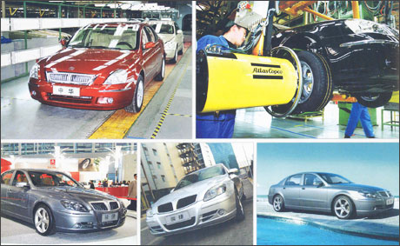
IMPACT OF BUDGET ON VARIOUS INDUSTRIES
AUTOMOBILE INDUSTRY
The budget announcements are not likely to have any major impact on the automobile sector.
Excise duty on motor vehicles having engine capacity exceeding 1999cc, has been reduced.
Excise duty on petrol motor vehicles for transport of goods except dumpers has been reduced from 20% to 8%.
Created & Presented By: - CA. Pradeep Jain Visit us at: www.capradeepjain.com
Created & Presented By: - CA. Pradeep Jain “Your Need Our Concern” Visit us at: www.capradeepjain.com

Slide 18
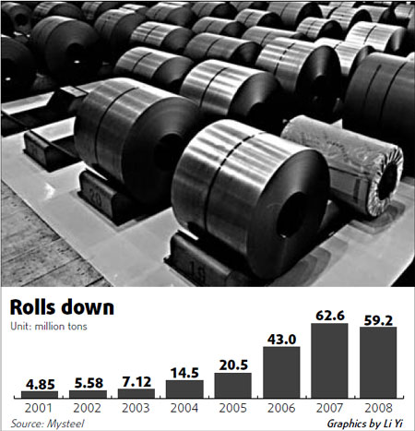
IMPACT OF BUDGET ON VARIOUS INDUSTRIES
STEEL INDUSTRY
The budget impact for the steel industry is expected to be neutral with no effect on industry profitability.
However, with the provision of higher investment in infrastructure segments such as roads, railways and urban infrastructure under Jawaharlal Nehru National Urban Renewal Mission (JNNURM), the demand for steel is likely to improve marginally.
Created & Presented By: - CA. Pradeep Jain Visit us at: www.capradeepjain.com
Created & Presented By: - CA. Pradeep Jain “Your Need Our Concern” Visit us at: www.capradeepjain.com

Slide 19



IMPACT OF BUDGET ON VARIOUS INDUSTRIES
PRECIOUS METALS AND JEWELLERY INDUSTRY
Branded jewellery have been fully exempted from excise duty.
Rates of basic customs duty on gold and silver have been increased and it includes gold/silver ornaments imported as baggage.
Rates of basic customs duty on gold and silver have been increased as under:-
S.no. Item From To
Gold bars, and gold coins Rs. 100 Rs. 200 per 10 gm per 10 gm
Gold in any form (other than Rs. 250 per Rs. 500 per
specified in S. No. 1) 10 gm 10 gm
Silver in any form Rs. 500 Rs. 1,000
per Kg per Kg
Created & Presented By: - CA. Pradeep Jain Visit us at: www.capradeepjain.com
Created & Presented By: - CA. Pradeep Jain “Your Need Our Concern” Visit us at: www.capradeepjain.com

Slide 20


IMPACT OF BUDGET ON VARIOUS INDUSTRIES
PHARMA AND MEDICAL INDUSTRY
BCD on some life saving drugs has been reduced from 10% to 5%.
CVD on these items would also be exempted by virtue of full exemption from excise duty.
BCD is being reduced from 7.5% to 5% with Nil CVD on followings:
  Artificial Heart.
  Patent Ductus Arteriosus/ Atrial Septal Defect occlusion devices.
Now the cosmetic surgery and plastic surgery will also in service tax net. And also includes ‘non-invasive’ surgery.
Created & Presented By: - CA. Pradeep Jain Visit us at: www.capradeepjain.com
Created & Presented By: - CA. Pradeep Jain “Your Need Our Concern” Visit us at: www.capradeepjain.com

Slide 21

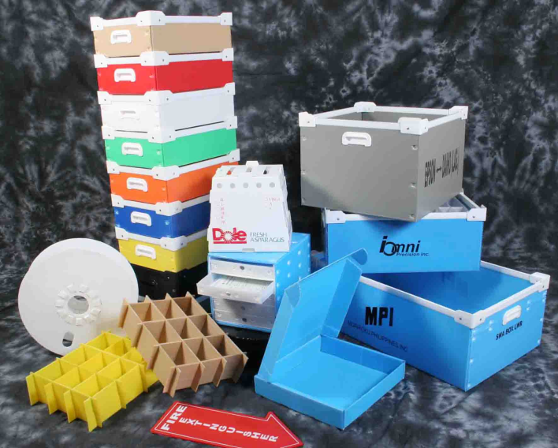
IMPACT OF BUDGET ON VARIOUS INDUSTRIES
PLASTIC INDUSTRY
There is no change either in the exemption limit or the eligibility limit for the small scale exemption.
Specified items that are in the nature of packaging material are excluded from the purview of the brand name restriction. i.e. ‘printed laminated rolls’
Excise duty on Polyester chips has also been enhanced from 4% to 8% ad valorem.
Created & Presented By: - CA. Pradeep Jain Visit us at: www.capradeepjain.com
Created & Presented By: - CA. Pradeep Jain “Your Need Our Concern” Visit us at: www.capradeepjain.com

Slide 22

IMPACT OF BUDGET ON VARIOUS INDUSTRIES
EXPORT INDUSTRY
Changes in the scheme for refund of service tax to the exporters of goods, in state of old scheme.
The following two services have been exempted for the exporters of the goods-
  Transport of goods by road, from the place of removal to any ICD, CFS, port or airport; or from any CFS or ICD to the port or airport; and
  Services provided by a foreign commission agent for procuring orders.
Notification No. 41/2007-ST (refund of service tax) is being superseded by Notification No. 7/2009-STdated 07.07.2009 prescribing new refund scheme in respect of 16 taxable services.
Service of ‘terminal handling’ has been added in the existing list of taxable services.
Full exemption from customs duty on specified raw materials/inputs imported by manufacturer-exporters of following goods has been extended to few additional items: 1. sports goods 2. leather goods
3. textile products 4. footwear industry
Created & Presented By: - CA. Pradeep Jain Visit us at: www.capradeepjain.com
Created & Presented By: - CA. Pradeep Jain “Your Need Our Concern” Visit us at: www.capradeepjain.com

Slide 23

IMPACT OF BUDGET ON VARIOUS INDUSTRIES
CHARTERED ACCOUNTANT SERVICE
No Service tax exemption is granted to the chartered accountant service.
Now exporters will get the Service tax refund with certificate of Chartered accountant. Wide NT 17/2009, if the refund claim is more than 0.25% of FOB value.
Chartered Accoutants are also eligible for conducting cost audit under Section 14A and 14AA of Central Excise Act
Created & Presented By: - CA. Pradeep Jain Visit us at: www.capradeepjain.com
Created & Presented By: - CA. Pradeep Jain “Your Need Our Concern” Visit us at: www.capradeepjain.com

Slide 24

IMPACT OF BUDGET ON VARIOUS INDUSTRIES
LEGAL CONSULTANCY SERVICE
Like management or engineering consultancy service, any consultancy, advice or technical assistance provided is proposed to be subjected to service tax.
The levy would be limited to services provided by a business entity to another business entity and business entity excludes individual.
The services provided by an individual advocate either to an individual or even to a business entity would not liable to service tax.
The services provided by a corporate legal firm to an individual would also be outside the purview of taxable service.
Any service of appearance before any court of law or any statutory authority would also be kept outside this levy.
Created & Presented By: - CA. Pradeep Jain Visit us at: www.capradeepjain.com
Created & Presented By: - CA. Pradeep Jain “Your Need Our Concern” Visit us at: www.capradeepjain.com

Slide 25
Thank you
From :
CA Pradeep Jain
“SUGAN” H-29, Shastri Nagar,
Jodhpur
Your Need Our Concern
Created & Presented By: - CA. Pradeep Jain Visit us at: www.capradeepjain.com
Created & Presented By: - CA. Pradeep Jain “Your Need Our Concern” Visit us at: www.capradeepjain.com

