Slide 1
BUDGET PROPOSAL ON INDIRECT TAXES 2012
CA.PRADEEP JAIN

Slide 2
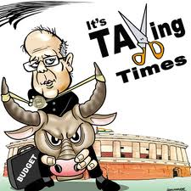
BUDGET 2012

Slide 3

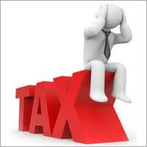
EXCISE – Increase in Duty
Increase in Standard rate of Central excise duty from 10% to 12%
Merit rate of excise duty increased from 5% to 6%
The rate of duty on 130 items which were charged to 1% increased to 2% (w/o CENVAT, with CENVAT chargeable to 6%)
Exception to above
- Coal
- All goods of chapter 31, other than those clearly not to be used as fertilizers
- Articles of Jewellery under heading 7113
- Mobile handset and cellular phones of heading 8517

Slide 4
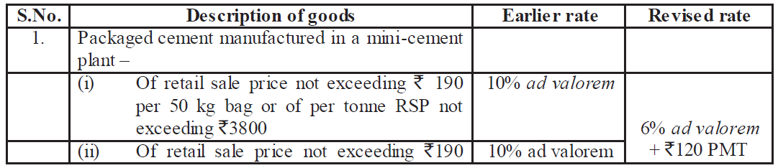
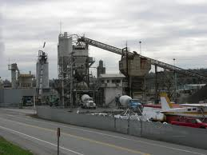
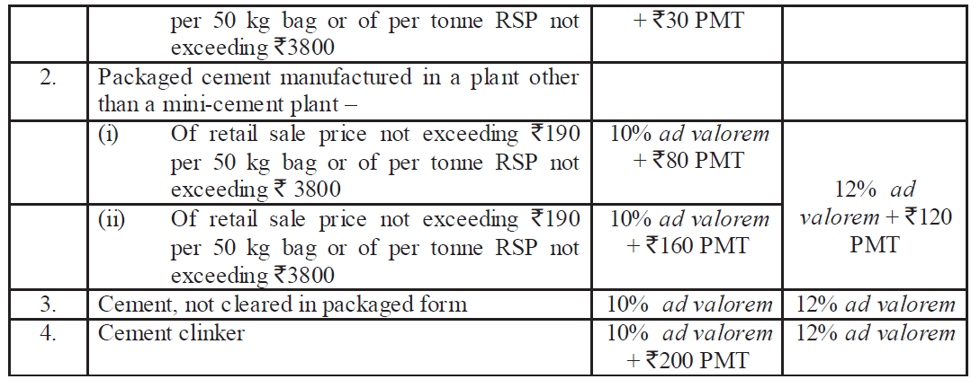
EXCISE – Increase in Duty
Rate of duty for cement changed as under

Slide 5
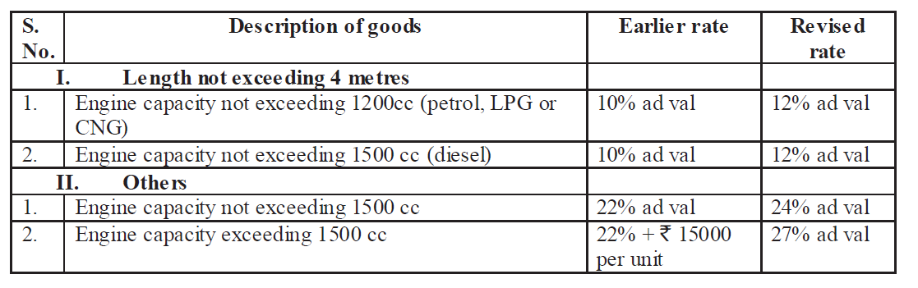

EXCISE – Increase in Duty
Rate of duty for motor vehicle increased as follows

Slide 6

EXCISE – Increase in Duty
Rate of duty of Rs.509 per 1000 sticks currently applicable to cigarettes of length not exceeding 60mm will now apply to cigarettes of length not exceeding 65mm
Excise duty on cigars, cheroots and cigarillos increased to 12% or Rs.1370 per thousand, whichever is higher
Excise duty on bidis for hand rolled increased
to Rs.10 per thousand sticks and for machine roll bidis to 21 per thousand sticks
Rate of duty for Pan masala, Gutkha , Chewing tobacco ,Zarda scented tobacco and unmanufactured tobacco in pouches increased as per notfn no. 13/2012 CE and 14/2012 CE

Slide 7
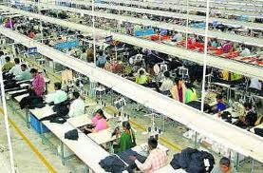
EXCISE – Increase in Duty
The rate of excise duty applicable to ready-made garments and made -up articles of textiles falling under Chapters 61, 62 and 63 (heading nos.63.01 to 63.08) of the Central ExciseTariff except those falling under heading nos.63.09 and 63.10 when they bear or are sold under
a brand name has been increased
from 10% to 12%. However, the tariff
value for these items has been revised
and shall now be equal Retail Sale Price
(RSP) less abatement of 70% instead of
55%. In other words, duty would be payable on 30% of the RSP.

Slide 8
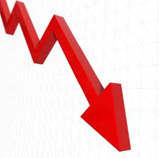

Excise duty – Reduction in duty
Parts, components and specified accessories viz. battery chargers, PC Connectivity Cables, Memory cards and hands-free headphones required for the manufacture of mobile phones are fully exempt. However, standard rate is chargeable when such goods are cleared as spares.
Excise duty has been reduced from 10% to 6% on:
- Matches manufactured by semi – mechanised units,
LED lamps, processed food products of soya, parts of blood pressure monitors and blood glucose monitoring systems
Specified raw materials polypropylene,stainless steel strip and stainless steel capillary tube for manufacture of syringe,needle, catheters and cannuale on actual user basis.

Slide 9

EXCISE – Changes in duty
Rate structure on footwear being rationalized in to two slabs as follows
- Footwear with RSP not exceeding Rs.500 per pair fully exempted
- Duty chargeable @ 12% on footwear with RSP exceeding Rs.500 per pair
Levy of excise duty on precious metal jewellery now also been extended to unbranded precious metal jewellery (except silver
jewellery). Duty shall be chargeable on tariff value
and tariff value is 30% of transaction value as specified
in section 4
Full exemption provided to branded silver jewellery and to gold & silver coins of purity 99.5% when they are manufactured from gold and silver on which customs duty or excise duty has been paid.
Rate of duty for chassis falling under heading 8706 rationalized

Slide 10
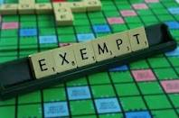
Excise duty – Exemption
Full exemption from excise duty available to ship and vessels now be available subject to fulfillment of conditions
Full exemption has been granted to
- Specified raw materials viz. stainless
steel tube and wire, cobalt chromium tube,
Hayness Alloy-25 and polypropylene mesh
required for manufacture of Coronary stents/ coronary stent system and artificial heart valve on actual user basis.
- Refills and inks in bulk packs (not meant for retail sale) used for manufacture of pens of value not exceeding ` 200 per piece.
- MS Pipes of diameter 30cm used in collector well, infiltration well for water purification eligible for exemption from excise duty under serial no.233 if notification no.12/2012 C.E. dated 17.03.2012

Slide 11
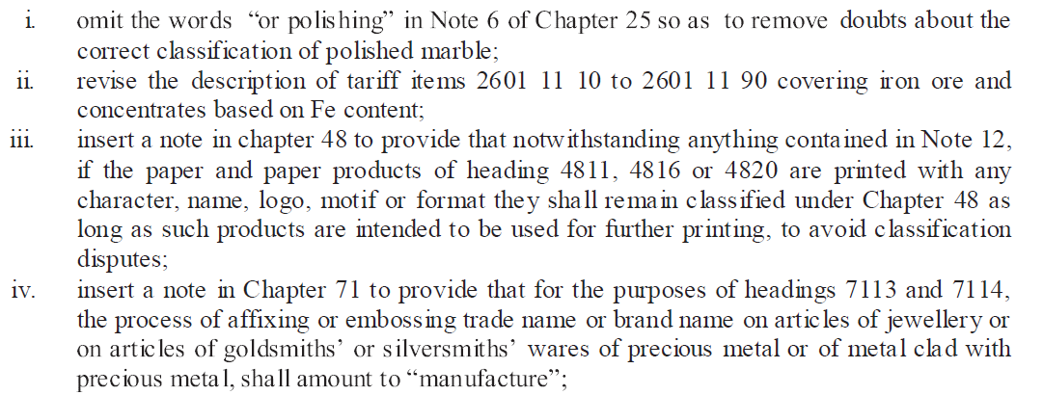
Excise – Changes in Central Excise Tariff

Slide 12
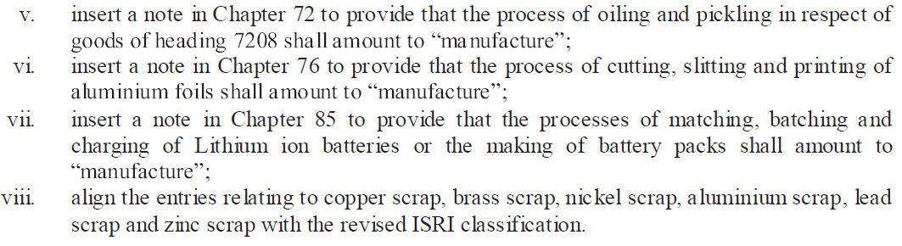
Excise – Changes in Central Excise Tariff

Slide 13
Changes in CENVAT Credit Rules
Now Credit on all motor vehicles shall be allowed other than those falling under tariff heading 8702,8703,8704,8711 and their chassis will be allowed. The credit of service tax paid on hiring, insurance and repair will also be allowed.
Following credit in respect of vehicles shall also be allowed
(i) insurance to motor insurance companies (as reinsurance and third party insurance) and manufacturers
(ii) Repair of vehicles to manufacturers in respect of motor vehicles manufactured by them and to insurance companies in respect of motor vehicles insured/reinsured by them

Slide 14
Changes in CENVAT Credit Rules
Rule – 3(5) and 3(5A) are being amended to prescribe that in case the capital goods on which CENVAT credit has been taken are cleared after being used then the amount payable shall be either the amount calculated on the basis of CENVAT credit taken at the time of receipt reduced by a prescribed percentage or the duty on transaction value whichever is higher.
Sub Rule – 4(1) and 4(2) have been amended to allow credit of goods without bringing them in to premises subject to due documentation regarding their delivery and location.
Changes are being made in Rule 7 relating to distribution of credits of input services by an input service distributer (ISD) to ensure their scientific allocation to only such units where they have been put to use and proportionate to turnover.

Slide 15
Changes in CENVAT Credit Rules
Rule (9)(1)(e) is being amended to allow availment of credit on tax payment challan in case of payment of service tax by all service receivers on reverse charge
Rule 10A is being inserted to permit transfer of unutilized credit of SAD lying in balance at the end of each quarter to another factory of the manufacturer
Rule 14 amended to substitute word “or” with “and”. So now interest shall be payable when credit is taken and utilized wrongly. Decision of Ind Swift laboratories (2011 – TIOL – SC –CX) nullified.

Slide 16
Changes in CENVAT Credit Rules
Rule – 5 of CENVAT Credit Rules relating to refund of CENVAT credit is simplified now, the new scheme does not require the kind of correlation that is needed at present between exports and inputs used in such exports. Duties or taxes paid on any goods or services that qualify as inputs or input services will be entitled to refund in the ratio of export turnover to total turnover.
New Formula is as follows
Refund amount = (Export turnover of goods+ Export turnover of services) x Net CENVAT credit
Total turnover

Slide 17

EXCISE – Amendments in Central Excise Act
For offences involving excisable goods as per sec 9(1)(i) of act, in which duty leviable exceeds Rs. 1Lakh which are punishable with term imprisonment for a term which may extend to seven years and fine, duty leviable for the same is increased to
30 lakhs
Sec 13 revised to provide that offences punishable
with imprisonment of three years or more under sec 9
shall be cognizable. Supreme court decision in case of
Om Prakash v/s UoI (2011-TIOL-95-SC-CX-LB) nullified.
Sec 13A being inserted to provide that bail in case of offences punishable with a term of imprisonment of three years or more under sec 9 shall not be granted without an opportunity being given to the public prosecutor to present his case.

Slide 18

EXCISE – Amendments in Central Excise Act
Sec 11AC being amended to make available benefit of reduced penalty only if the reduced penalty is also paid within specified period of 30 days.
Sec 12 F relating to search and seizure
being amended to align with the
provisions of Customs act
Sec 18 being substituted to provide that save as provided under the Central excise act, searches shall be carried out as per procedure laid down in the Code of criminal procedure.

Slide 19
EXCISE – Amendments in Central Excise Rules & Other Miscellaneous
Rule 22(3) being amended to empower officers of audit, cost accountants and chartered accountants appointed under sec 14A or 14AA to prescribe time limit within which the units being audited will produce the documents
The rate of cess leviable as a duty of excise on crude petroleum under oil industries and development increase to Rs.4500 per MT from Rs.2500 per MT
Concessional rate of Rs.30 per sq mtr also available to polished marble slabs of heading 68022190. Relevant exemption entry also amended to include CETH 6802 2190

Slide 20

Service tax – Increase in rate
Rate of service tax being increased to 12% from 10%. Consequent changes also being made in composition rate as follows
(i) For Life insurance – 3% for the first year premium
while rate of 1.5% is being retained for subsequent years.
(ii) Money changing – Existing rates being raised proportionately by 20%
(iii) Works contract – From 4% to 4.8% for composite contract.
Rate for CENVAT reversal for exempt services has been revised from 5% to 6% in Rule – 6(3) of CCR’04
Dual tax structure for air transportation being replaced with uniform ad – valorem levy at standard rate with abatement of 60% on all sectors and all classes.

Slide 21

Service tax – Introduction of Negative list
In a major paradigm shift services now shall be taxable based on “Negative list of services”.
Thus if an activity meets the characteristics
of a “service” it is taxable unless specified in
the negative list
Negative list, comprising 17 heads are listed
under new section 66D or otherwise are exempted by a notification issued under sec 93 of the Act
On coming in to force of new provisions, the earlier provisions contained in sec 65,65A,66,66A will cease to apply but will remain relevant in respect of services provided prior to coming into force of new provisions.

Slide 22
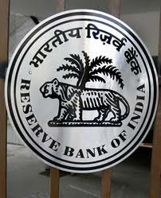

Service tax – Negative list
Following services are being included in negative list and thus shall not be liable to taxation
(1) Services provided by government or local authority
excluding certain services
(2) Services provided by Reserve Bank of India
(3) Services by a foreign diplomatic mission located in India
(4) Services relating to agriculture
(5) Trading of goods
(6) Any process amounting to manufacture
or production of goods
(7) Selling of space or time slots for advertisement other than advertisements broadcast by radio or television
(8) Service by way of access to road or a bridge or payment of toll charges
(9) Betting, gambling or lottery

Slide 23


Service tax – Negative list
(10) Admission to entertainment events or access to entertainment facilities
(11) Transmission or distribution of electricity by an electric transmission or distribution utility
(12) Services by way of
(a) Pre – school education and education
up to higher secondary school or equivalent
(b) education as part of curriculum for obtaining a
qualification recognised by any law for time being in force
(c ) Education as a part of approved educational vocational course
(13) Services by way of residential dwelling for use as residence
(14) Services by way of
(a) Extending deposit, loans or advances in so far
as the consideration is represented by way of interest or discount
(b) Inter – se sale or purchase of foreign currency among banks or authorised dealers of foreign exchange or amongst bank and such dealers

Slide 24
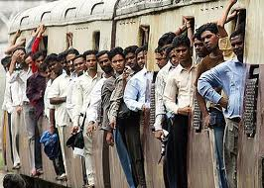
Service tax – Negative list
(15) Service of transportation of passengers with or without accompanied belongings by
  (a) by stage carriage
  (b) railways in a class other than
  (i) first class
  (ii)an air conditioned coach
  (c) metro,monorail or tramway
  (d) Inland waterways
  (e) Public transport other than predominantly for tourism purpose in a vessel of less than 15 tonne net
  (f) Metered cabs,radio taxis or auto rickshaws
  (16) Services by way of transportation of goods
  (a) by road except services of GTA or Courier agency
  (b) by an aircraft or a vessel from a place outside india
  (c) by inland water ways
  (17) funeral,burial,crematorium or mortuary services including transporation of deceased

Slide 25
Service tax – “Service” new definition
The word “service” is defined in clause (44) of new section 65B, according to the same
“Service” means any activity carried out by a person for another for consideration and includes declared service, but shall not include
  (a) an activity which constitutes merely
      (i) a transfer of title in goods or immovable property by way of sale,gift, or in any other manner
      (ii)a transaction in money or actionable claim
    (b) a provision of service by an employee to the employer in the course of or in relation to employment
    (c) fees taken in any court or tribunal established under any law for time being in force

Slide 26

Service tax – Declared services
The following shall constitute declared services as per sec 66E and hence shall be chargeable to taxation, however services other than that specified in declared list are also taxable unless specified in negative list
(a) renting of immovable property
(b) construction of complex,building,civil structure
or a part there of including a complex or building
intended for sale to a buyer, wholly or partly, except
where the entire consideration is received after issuance of completion certificate by the competent authority
(c) temporary transfer or permitting the use or enjoyment of any intellectual property right
(d) development,design,programming,customisation,adaptation,
upgradation,enhancement,implementation of information technology software
(e) agreeing to the obligation to refrain from an act, or to tolerate an act or situation, or to do an act

Slide 27

Service tax – Declared services
(f) transfer of goods by way of hiring, leasing,licensing or in any such manner without transfer of right to use such goods
(g)activities in relation to delivery of goods on hire purchase or any system of payment by instalments
(h) service portion in execution of a works
contract
(i) service portion in an activity where in
goods, being food or any other article of human consumption or drink is supplied in any manner as a part of activity

Slide 28


Service tax – Exempted service
Service tax exemption has been provided to many services by way of an exemption notification, few services are listed hereunder
(a) Services provided to United nations or specified international organisation
(b) Health care service provided by a clinical establishment,
an authorised medical practioner or para medics
(c) Services by an entity registered under sec 12AA of
Income tax Act,1961 by way of charitable activities
(d) Services provided to any person other than business entity by
(i) an individual as an advocate
(ii) a person represented on and as arbitral tribunals
(e) Services by way of training or coaching or recreational activities relating to arts, culture or sports

Slide 29
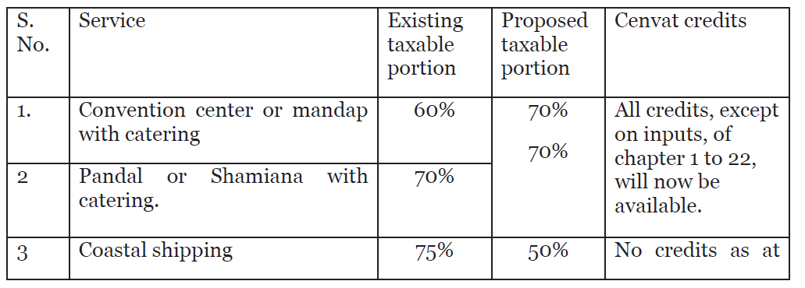
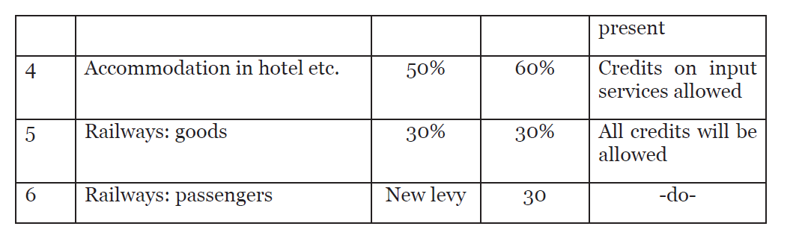
Service tax - Abatements
Certain Changes made in Abatement scheme , moreover now CENVAT credit on Input services is also available for certain services specified as follows

Slide 30

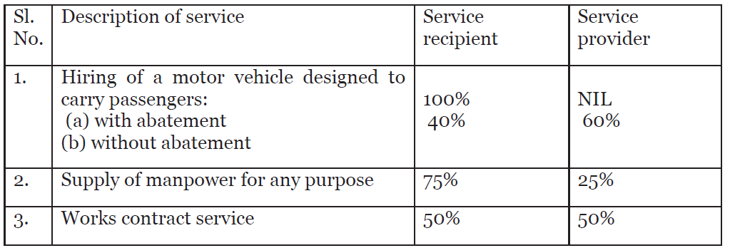
Service tax – Reverse charge provisions
For the first time in service tax provision both service recipient and service provider are being made liable to pay service tax on notified taxable services to the extent specified against each one of them as follows
The scheme is applicable where service provider is individual,LLP,firm and recipient is body corporate

Slide 31
Service tax – Point of taxation
The time period for issuance of invoice is being increased to 30 days ordinarily and 45 days for banking and financial institution
The benefit to determine POT on the basis of date of payment extended to all services. The same is available if provided by Individuals and Partnership firms (including LLP) up to turnover of Rs.50 lakhs in a financial year and provided the taxable turnover did not exceed this limit in previous financial year
Small scale exemption is also amended providing that first clearances up to Rs.10 lakhs will be in terms of invoices and not in terms of payment received

Slide 32
Service tax – Point of taxation
Definition of continuous supply of service being amended to “recurrent nature of services and obligation for payment periodically or from time – to – time
In case of new levy, no tax is chargeable on services where payment has been received and invoice issued within a period of 14 days.
In normal circumstances POT shall be earlier of the dates of entry in to books of accounts or actual credit in bank of account. However, when there is a change in effective rate of tax or a new levy between the said two dates, the date of payment shall be the date of actual credit in bank account.

Slide 33
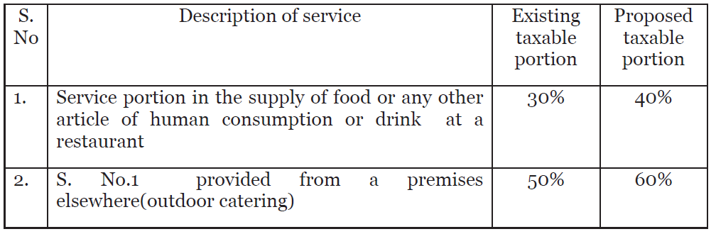
Service tax – Valuation Rules
New valuation rule being introduced for works contract services
New Rule 2C being introduced for determination of taxable service involved in supply of food and drinks in restaurant or as outdoor catering, the revised taxable portion is as follows

Slide 34
Service tax – Valuation Rules
Rule – 3 of Valuation rules shall now be applicable only in cases where valuation is “not ascertainable” instead of current situation i.e where consideration received is not wholly or party consisting of money
Rule – 6 prescribes inclusions and exclusions to the taxable value , now value of taxable service shall include “any amount realized as demurrage, or by any other name, for the provision of a service beyond the period originally contract or in any other manner relatable to provision of service
It shall exclude “accidental damages due to unforeseen actions not relatable to the provision of service”

Slide 35
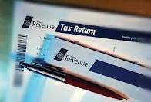
Service tax - Payment
The date of filing of return and payment of service tax is now same as follows
Assessees who paid tax of Rs.25 Lakh
or more in previous year and new assessees
other than individuals and firms – Monthly
Others - Quarterly

Slide 36
Service tax – Other Changes
Special audit provisions replaced by new sec 72A giving comprehensive powers for audit for service tax purpose
The period for issue of demands in normal situations is being raised from 12 months to 18 months.
A new sub-section (1A) is being inserted to save the botheration of retyping
the same charges (and save paper) when a follow-up demand is given for a period subsequent to the previous notice(s) on same grounds;
The period for filing appeals in service tax is now 2 months and it is aligned with that of Central excise
Provisions relating to settlement commission are being brought in service tax
Revision mechanism also being introduced in service tax
In clause (a) of sec 89 relating to prosecution for non issue of invoice is being replaced with words “knowingly evade payment of tax”

Slide 37
Service tax – Other Changes
Penalty is waived for those taxpayers who pay the service tax due on renting of immovable property service in full along with interest within six months (from 06.03.2012)
Service tax refunded will be recoverable, without any time bar from exporter, against whose shipping bill, sale proceeds have not been received from abroad.
New Rules known as “Place of provision of service rules,2012” are being proposed and draft has been released for comment and feedback. The new rules will replace the existing export of services rules,2005 and Taxation of services (Provided from Outside India and received in India) Rules,2006.

Slide 38
Common provisions – Excise and Service tax
New registration format for Central Excise and Service tax is being prescribed, together with further liberalization in registration requirements, particularly registrations.
New one page common return, to be called Excise & Service tax return (EST) is introduced

Slide 39

Customs
No change in peak rate of customs duty of 10% as as applicable to non – agricultural goods with few exceptions. Rates below peak rate also being retained.
Notification no.21/2002 Cus prescribing
general rates being superceded by
Notification no. 12/2012 – Cus
Duty free allowance under the
baggage rules being increased
from Rs.25000 to Rs.35000 for passengers of Indian origin and from Rs.12000 to Rs.15000 for children up to 10 years of age

Slide 40
Customs
Method of computation of Edu cess and SHEC on imported goods being simplified, now the portion of cesses leviable on the CVD portion of customs duty being exempted so as to avoid computation of cesses twice

Slide 41
Customs
Notification no.21/2012 prescribes new effective rates of Special Additional Duty (SAD) and also exempts certain product from SAD.
A condition being inserted requiring the importer of specified goods to declare the state of destination where the goods are intended to be sold for the first time after import and the VAT registration no. This condition would apply to such goods imported on or after 01.05.2012
New sec 28AAA being inserted to provide for recovery of duties, from the person to whom the instrument such as duty credit scrips was issued, where the instrument was obtained by means of collusion or wilful mis-statement by such person without prejudice to any action that may be taken against the importer.
All offences under the Act punishable with a term of imprisonment of three years or more under sec 135 shall be cognizable or non bailable in alignment with Central Excise Act.

Slide 42


INDUSTRY Impact - Automobiles
Duty for motor vehicle for engine capacity
Exceeding capacity 1500cc increased to
27%
Basic customs duty to be enhanced for certain categories of completely built unit of large cars MUVs/SUVS

Slide 43

INDUSTRY Impact - Tobacco
Excise duty to be increased on demerit
goods such as certain cigarettes,hand
rolled bidis, pan masala, gutkha, chewing
tobacco, unmanufactured tobacco and zarda
scented tobacco

Slide 44


INDUSTRY Impact – Mobile/Telecommunication
Parts, components and specified accessories viz battery chargers, PC Connectivity cables, Memory cards and hands free headphone required for the manufacture of mobile phones are fully exempt.

Slide 45
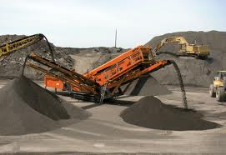
INDUSTRY Impact – Mining
Full exemption from basic customs duty
to coal mining projects
Basic custom duty proposed to be
reduced for machinery and instruments
needed for surveying and prospecting of minerals

Slide 46

INDUSTRY Impact – Health
Proposal to extend concessional basic
customs duty of 5 per cent with full
exemption from excise duty/CVD to
6 specified life saving drugs/vaccines.
Basic customs duty and excise duty
reduced on Soya products to address
protein deficiency among women and
children.
Basic customs duty and excise duty
reduced on Iodine.
Basic customs duty reduced on Probiotics.

Slide 47
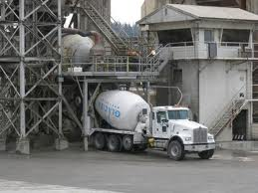
INDUSTRY Impact – Cement
Rate of Excise duty for Cement not cleared in packaged form and Cement Clinker being increased and for packaged cement manufactured in mini cement plant being rationalized

Slide 48
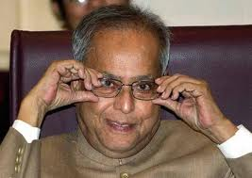

Budget 2012

Slide 49
CONTACT US
CA.PRADEEP JAIN
SUGYAN “H” – 29,SHASHTRINAGAR,
JODHPUR – 342003
TEL – 0291 – 2439496 , M – 9314722236
Visit us at – www.capradeepjain.com

