Slide 1

JODHPUR BRANCH OF CIRC OF ICAI
CPE SEMINARS & STUDY CIRCLE MEETINGS
IN THE MONTH OF DECEMBER, 2010
ONLINE REGISTRATION & RETURN FILING UNDER SERVICE TAX- E-FILING
Prepared and Presented by CA. Pradeep Jain → www.capradeepjain.com
Notes:
1

Slide 2


Registration can be done for two kind of assesses: -
    Existing User
    New User
Prepared and Presented by CA. Pradeep Jain → www.capradeepjain.com

Slide 3


To,
The Superintendent (Service Tax)
Central Excise and Service Tax Ragne-II,
Jodhpur.
Sub : Request for allotment of TPIN and password.
Respected sir,
With reference to aforesaid subject, we hereby request
you to allot us TPIN and password. The required details
are as under :
Email address- ****@*****.com;
Registration No.- *************
Thanking you,
For ***********
AUTHORISED SIGNATORY
All existing assessees have to register with ACES to access its utilities and facilities.
After submitting the details an email containing a T-PIN number and a password would be sent to the assessee on said email id. Further a link will be provided in the email where you have to click on to register with ACES
Prepared and Presented by CA. Pradeep Jain → www.capradeepjain.com
Notes:
3

Slide 4
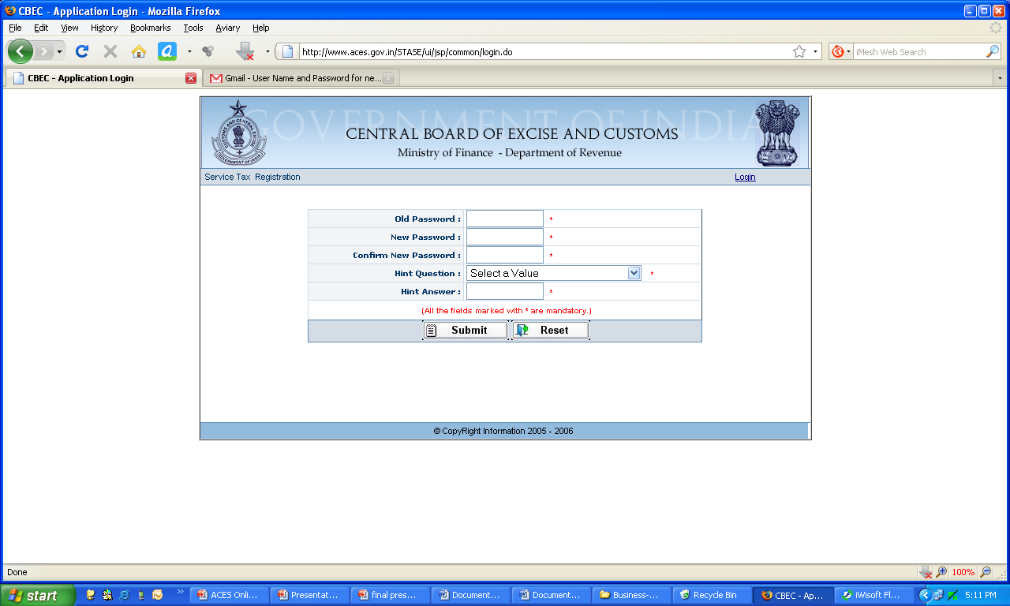
After clicking on link following screen will be displayed now you can change your password with a new one and enter Hint Question for future reference:-
Prepared and Presented by CA. Pradeep Jain → www.capradeepjain.com
Notes:
4

Slide 5
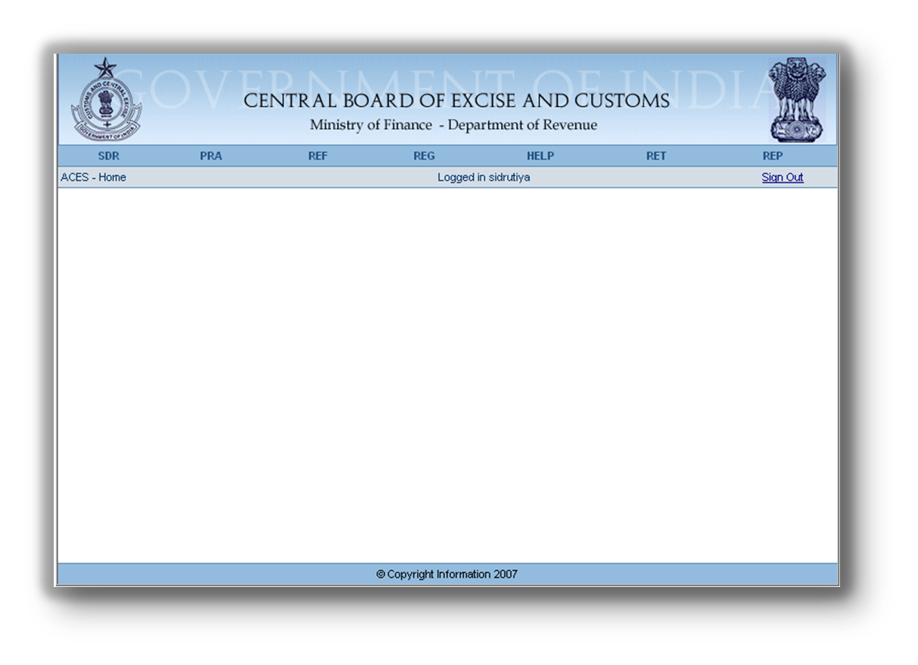
On successful change of password you have successfully created your ACES account. Now you can access various facilities available on “ACES-Home”.
Prepared and Presented by CA. Pradeep Jain → www.capradeepjain.com
Notes:
5

Slide 6
Registration can be done for two kind of assesses: -
    Existing User
    New User
Prepared and Presented by CA. Pradeep Jain → www.capradeepjain.com
Notes:
6

Slide 7

NEW USERS
DISCUSSION with Client
Category of Service Covered
Exemption, if Any .
Covered under Service Tax Levy
Not Covered under Service Tax Levy
Registration Required
Registration Not Required
Client has to Register online through- www.aces.gov.in
NO need to Register with ACES.
Prepared and Presented by CA. Pradeep Jain → www.capradeepjain.com

Slide 8
NEW USERS
Documents Required for Service Tax Registration: -
  Memorandum & Articles of Association – in case of company/ partnership deed in case of partnership firm
  Copy of pan card of firm
  Name, address, phone, Fax no., E-MAIL address and PAN no. of firm/company
  Name, residential address, phone no, Fax no., E-mail address of director/partners & Authorized signatory, if any
  Self attested copy of address proof of partner/proprietor/director or Authorized signatory
  Rubber Stamp or Seal of Firm
  Letter pads (5)
Prepared and Presented by CA. Pradeep Jain → www.capradeepjain.com
Notes:
8

Slide 9
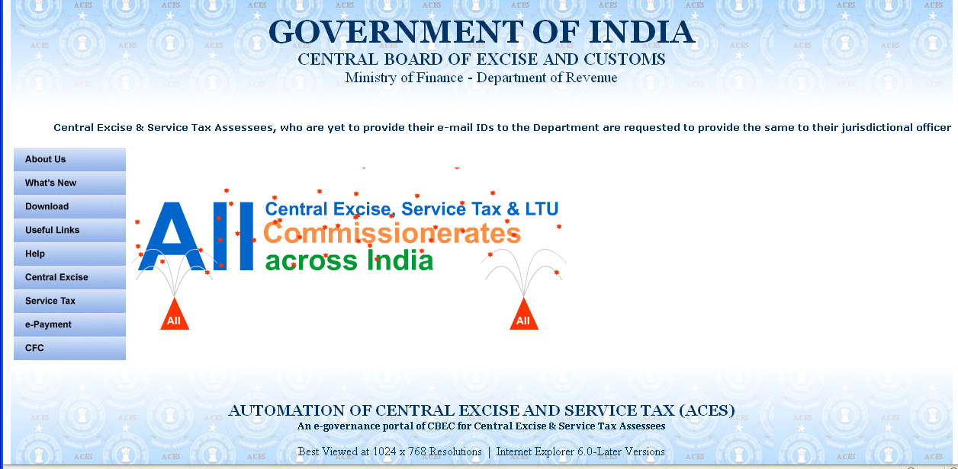
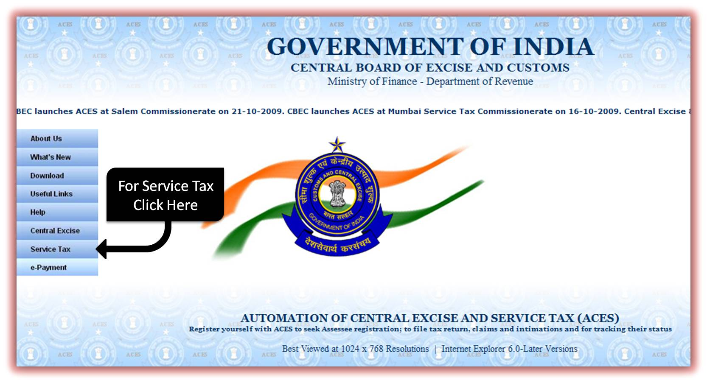
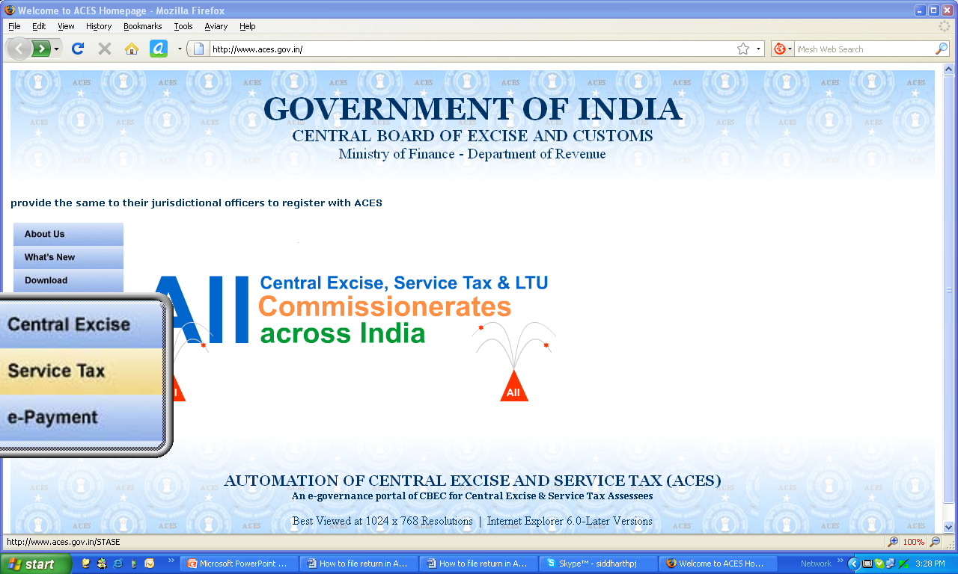
Online Registration Procedure
Open ACES home page http://www.aces.gov.in/ .
The below mentioned screen will be displayed.
Prepared and Presented by CA. Pradeep Jain → www.capradeepjain.com

Slide 10
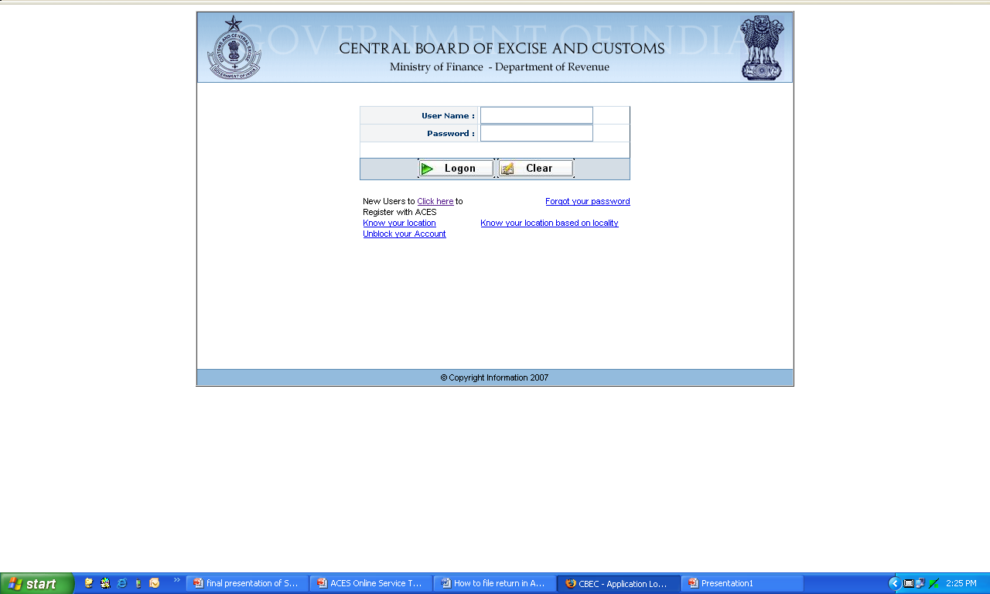
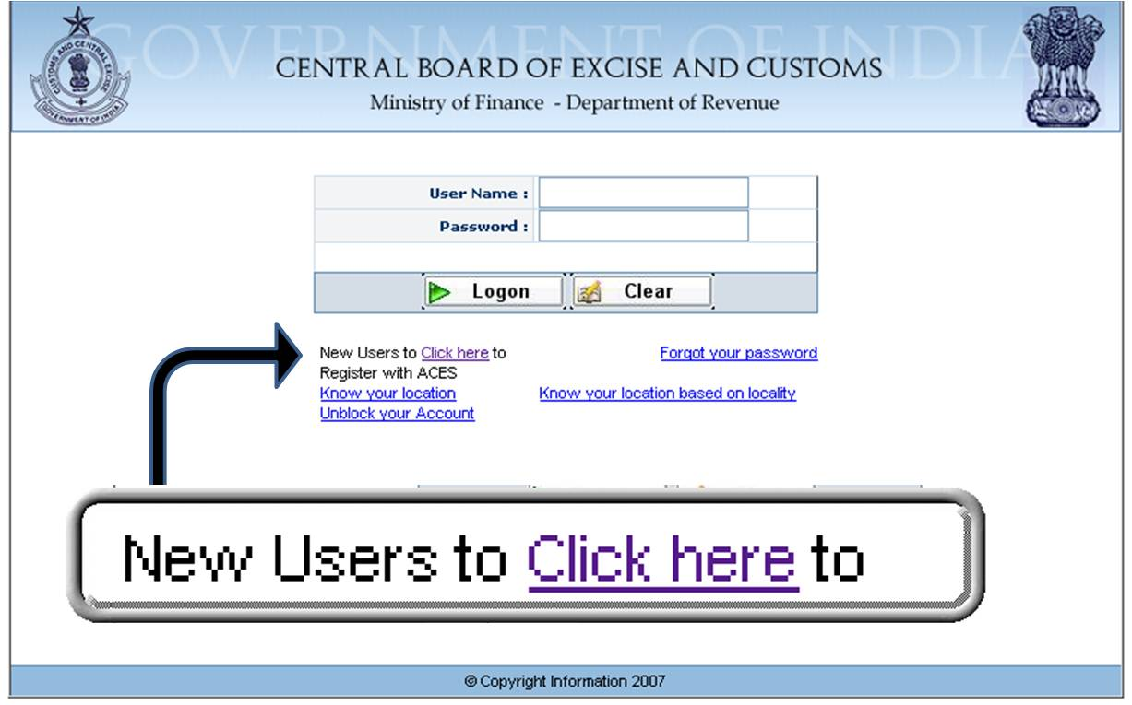
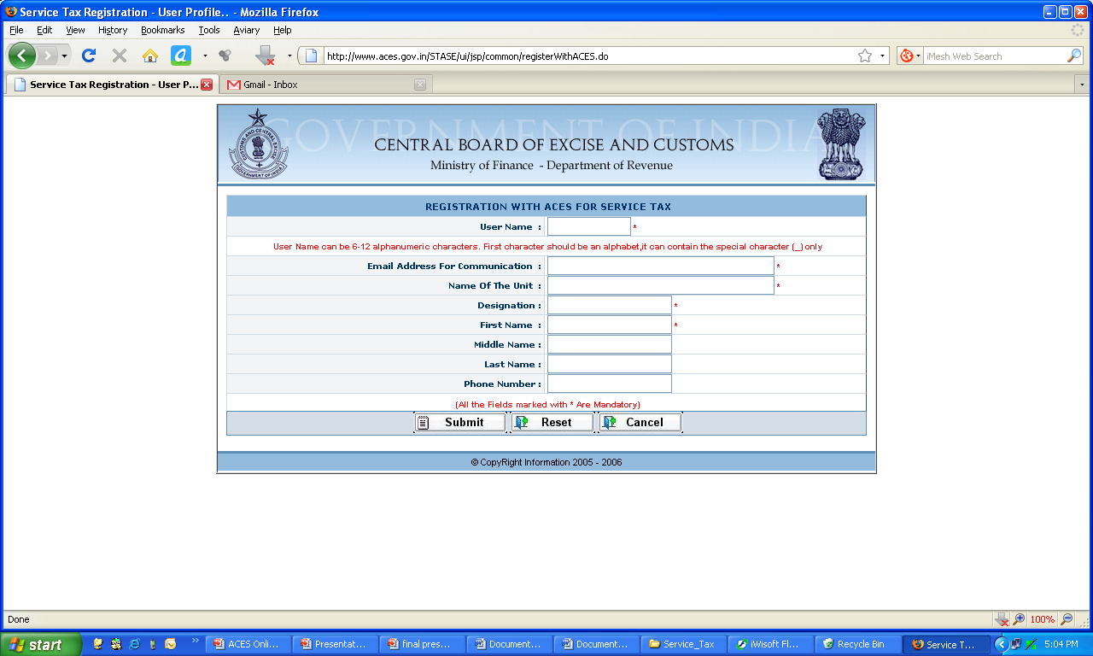
After clicking on Service tax Following Screen will be displayed:-
You need to click on “Click here to Register with ACES” link on the login page and submit the form “Registration with ACES” by furnishing a self-chosen user ID and e-mail ID.
An auto generated password will be sent on users email.
Remember Username (User Id) once selected cannot be changed however user can change password anytime using Change Password feature within ACES application.
Prepared and Presented by CA. Pradeep Jain → www.capradeepjain.com

Slide 11
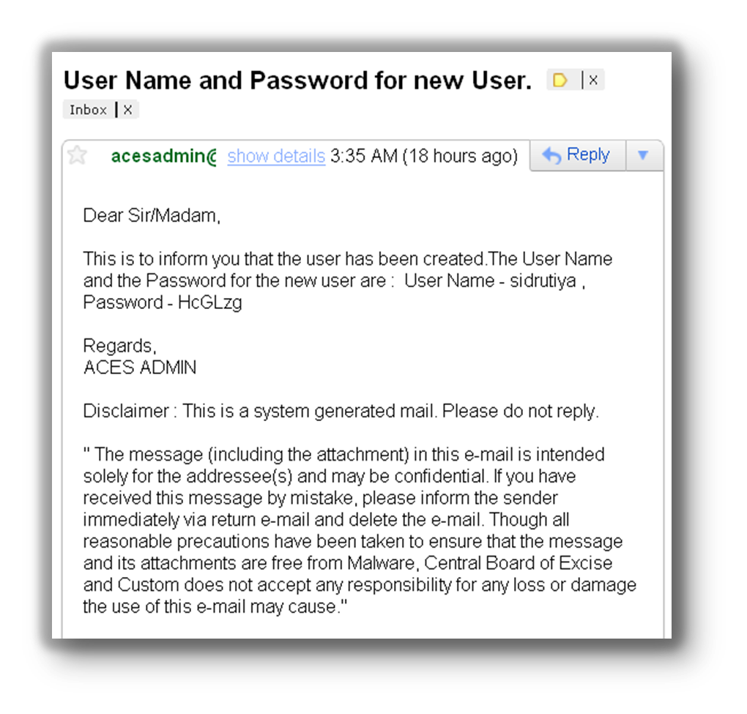
On successful registration with ACES following email will be sent to your email id containing user name and password: -
Use the allotted username and password to login the ACES website
Prepared and Presented by CA. Pradeep Jain → www.capradeepjain.com

Slide 12
On successful login the following screen will be displayed where user can change the password and select a Hint Question.
Those fields marked with asterisk (“*”) in application are mandatory fields and the same are to be filled before proceeding further.
Prepared and Presented by CA. Pradeep Jain → www.capradeepjain.com
Notes:
12

Slide 13
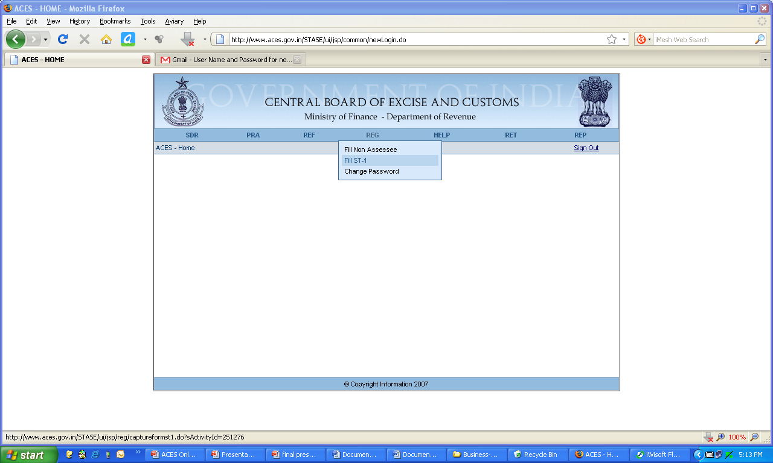
After change of password User is taken directly to the Home screen. Here User must click on “REG” Menu and select “Fill ST-1” option.
Prepared and Presented by CA. Pradeep Jain → www.capradeepjain.com

Slide 14
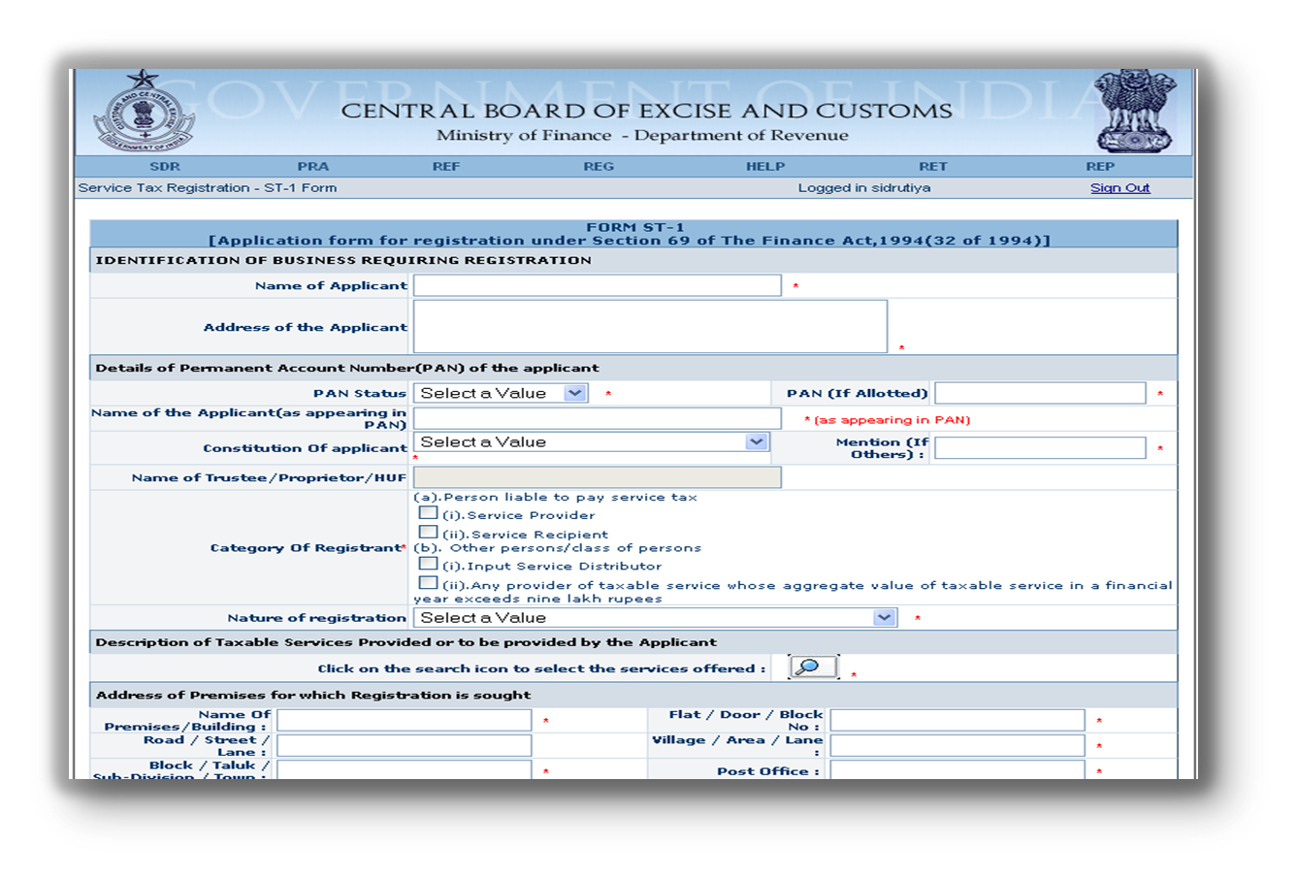
Now Form ST-1 appears on the user screen where he can fill the required details: -
Prepared and Presented by CA. Pradeep Jain → www.capradeepjain.com

Slide 15
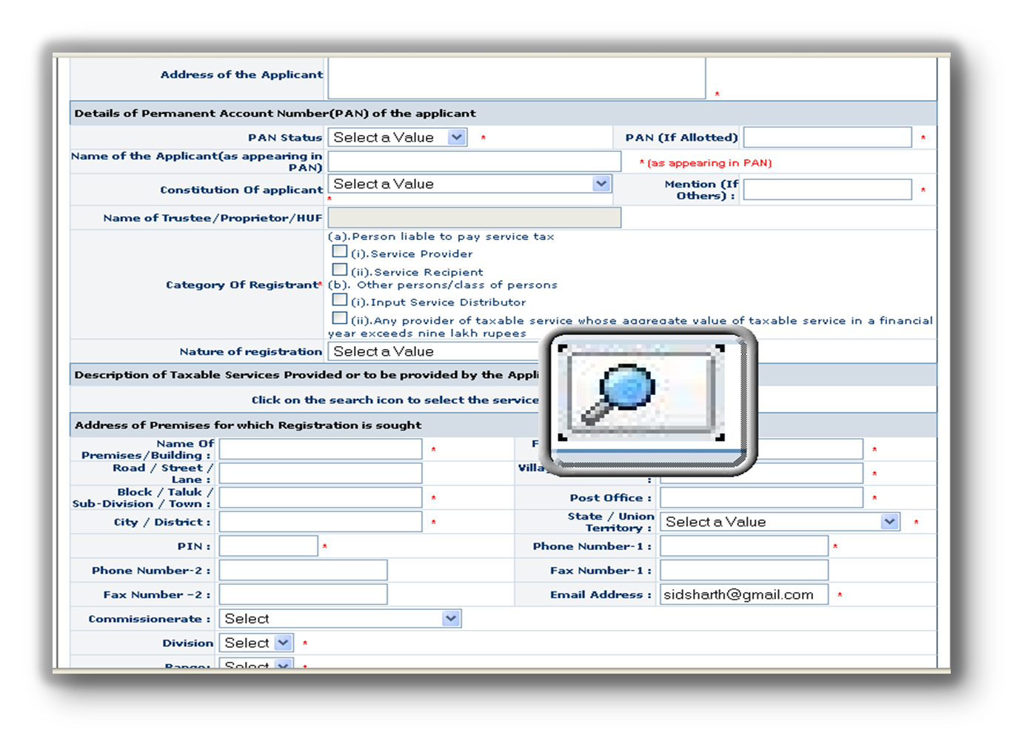
User has to click on the search button (as highlighted below) to select the appropriate category of service from a list of Services under which he is covered: -
Prepared and Presented by CA. Pradeep Jain → www.capradeepjain.com

Slide 16
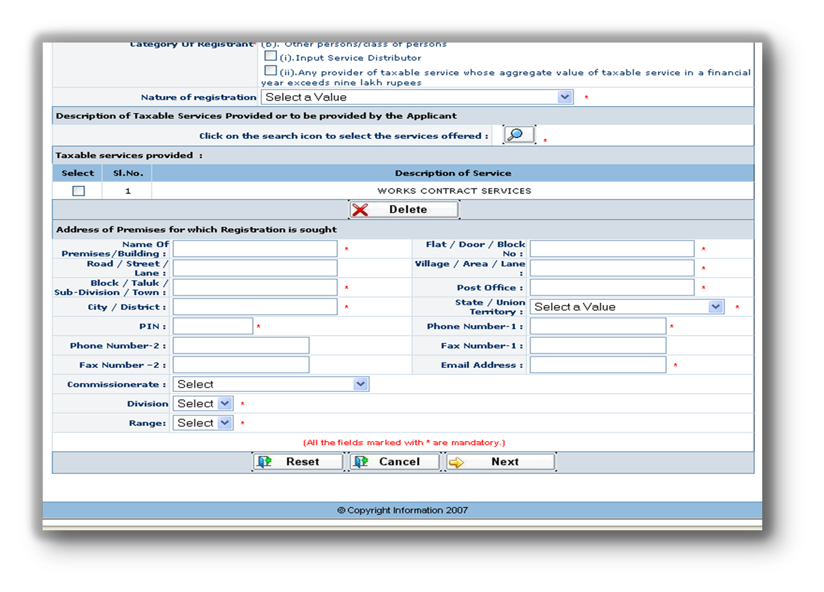
After filling the complete form click on the Next button to proceed further: -
Prepared and Presented by CA. Pradeep Jain → www.capradeepjain.com

Slide 17
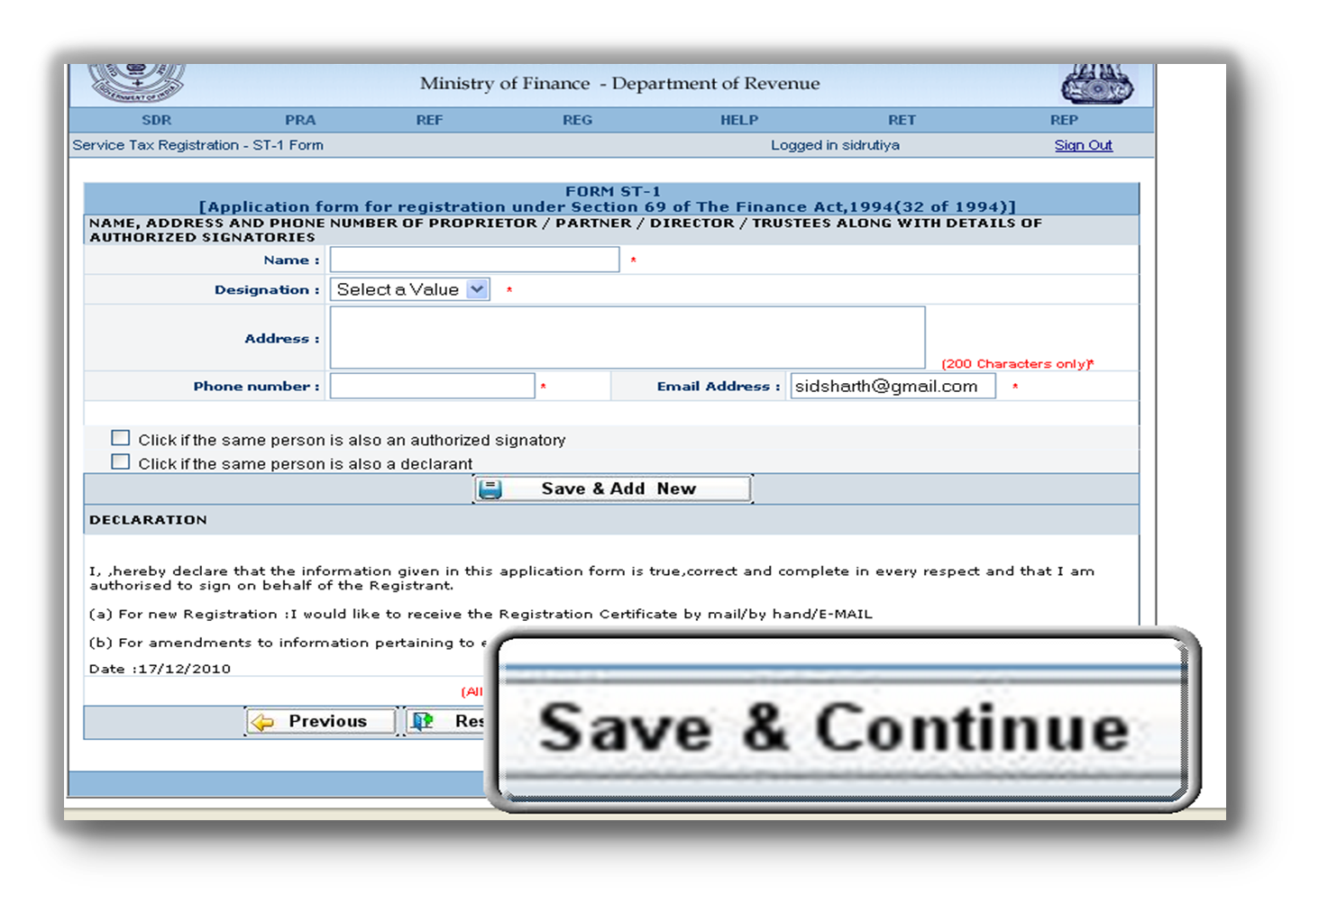
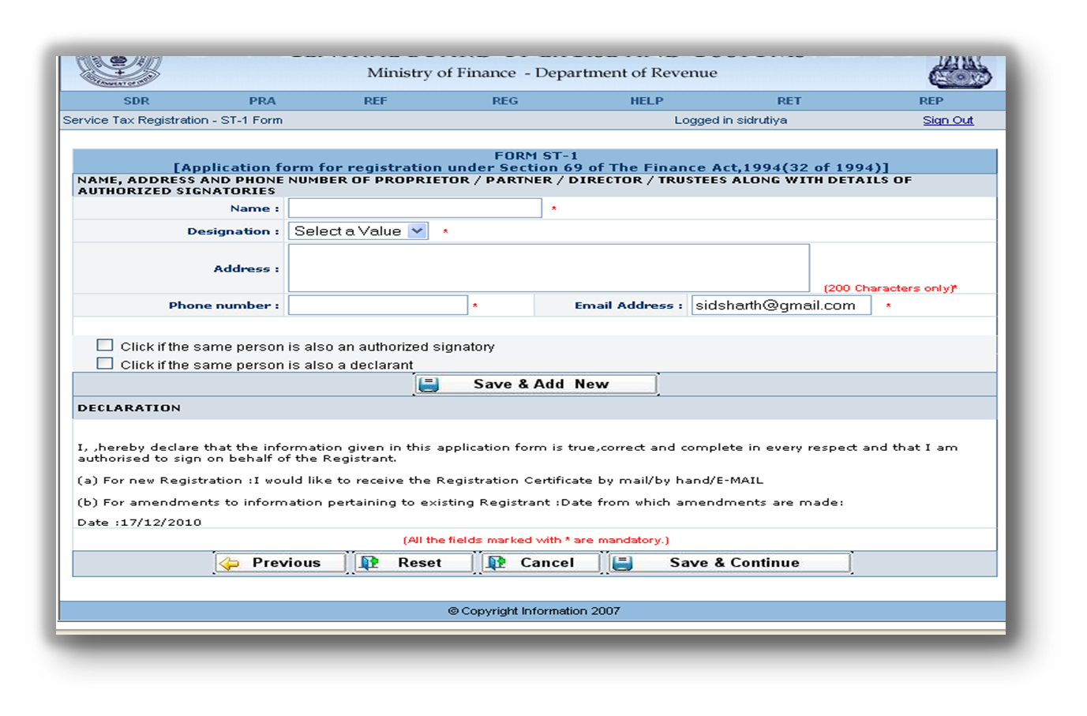
Now the user has to fill Details of Authorized Signatory. Once every thing is filled the user must click on “Save and Continue button”.
Prepared and Presented by CA. Pradeep Jain → www.capradeepjain.com

Slide 18
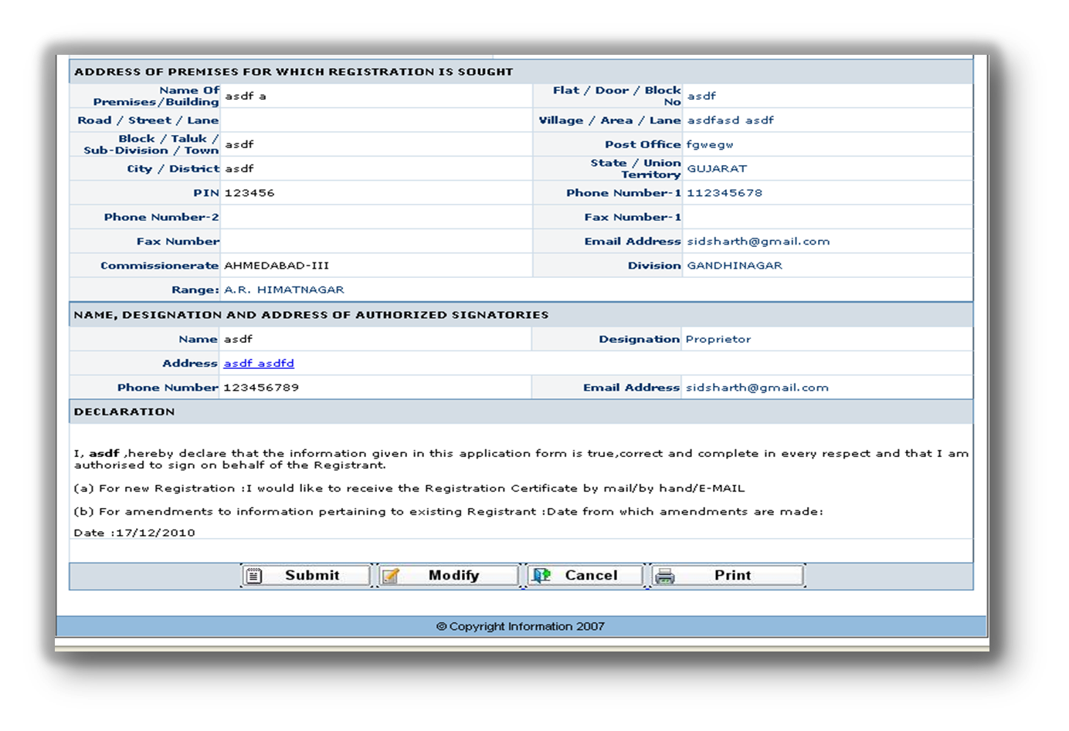
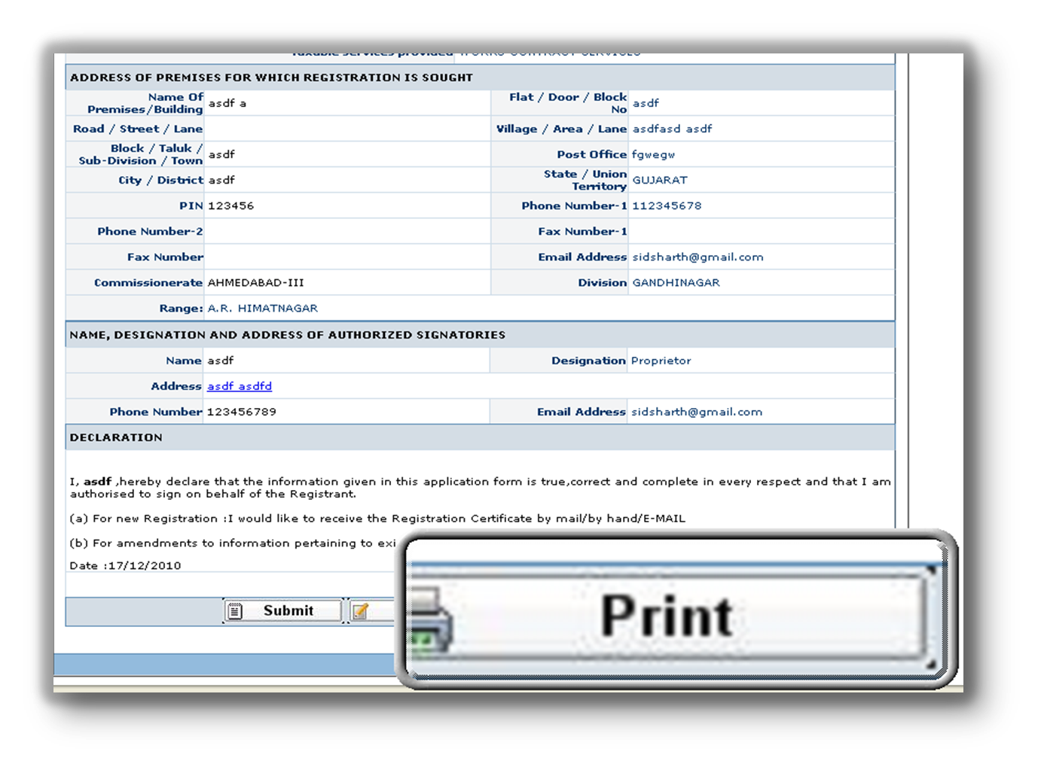
Now the printable version of dully filled ST-1 appears. User must check the details and if incorrect can change them by clicking on “Modify” button. If every thing is in order then before submitting the form user has to click on the “Print” button to get the hard copy for future use.
Prepared and Presented by CA. Pradeep Jain → www.capradeepjain.com

Slide 19
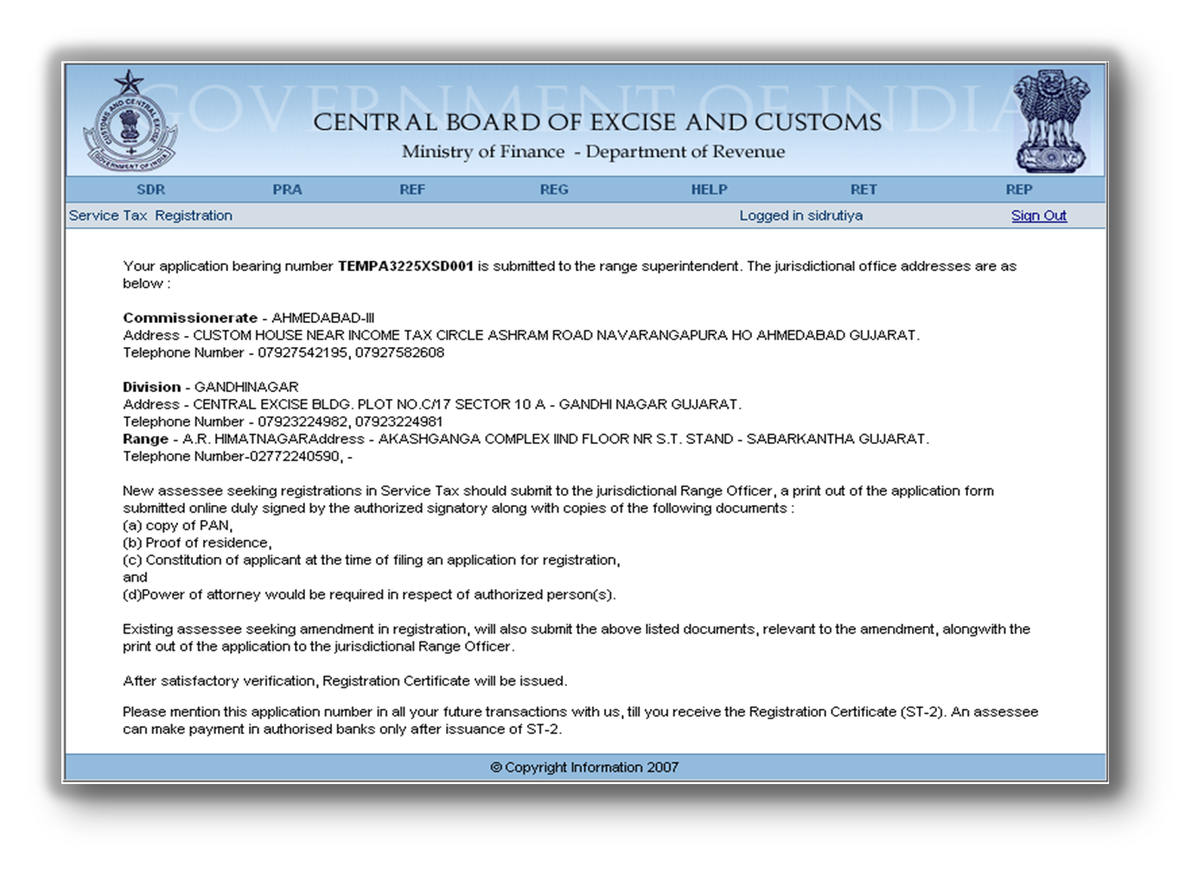
After successful submission of the form, an acknowledgement appears which confirms the submission. A unique number appears on this page which is the Registration Number and can be noted for future references: -
Prepared and Presented by CA. Pradeep Jain → www.capradeepjain.com

Slide 20


After filing registration application online, submit hard copy of the same to the concerned jurisdictional officer along with supporting documents.
After viewing the particulars in the application the jurisdictional Deputy Commissioner/Assistant Commissioner generates the Registration Certificate. The registration certificate is duly signed and sent to the Assessee. The assessee can also view the Registration Certificate under the REG menu.
Prepared and Presented by CA. Pradeep Jain → www.capradeepjain.com

Slide 21
Thank you !
Prepared and Presented by CA. Pradeep Jain │www.capradeepjain.com │ Page no. 1
Prepared and Presented by CA. Pradeep Jain → www.capradeepjain.com

